Slide 1

Apache Oozie
Arpan Sapkota [097-BCT-2073]
Nischal Pokharel [115-BCT-2073]

Slide 2
Introduction to Oozie
Workflow scheduler for Hadoop
Manages Hadoop Jobs
Integrated with many Hadoop apps i.e. Pig
Scaleable
Schedule jobs
A workflow is a collection of actions i.e.
– map/reduce, pig, hfs
A work flow is
– Arranged as a DAG ( Direct Acyclic Graph )
– Graph stored as hPDL ( XML process definition )
Notes:
Apache Oozie is a scheduler system to run and manage Hadoop jobs in a distributed environment. It allows to combine multiple complex jobs to be run in a sequential order to achieve a bigger task. Within a sequence of task, two or more jobs can also be programmed to run parallel to each other.
One of the main advantages of Oozie is that it is tightly integrated with Hadoop stack supporting various Hadoop jobs like Hive, Pig, Sqoop as well as system-specific jobs like Java and Shell.
Oozie is an Open Source Java Web-Application available under Apache license 2.0. It is responsible for triggering the workflow actions, which in turn uses the Hadoop execution engine to actually execute the task. Hence, Oozie is able to leverage the existing Hadoop machinery for load balancing, fail-over, etc.
Oozie detects completion of tasks through callback and polling. When Oozie starts a task, it provides a unique callback HTTP URL to the task, and notifies that URL when it is complete. If the task fails to invoke the callback URL, Oozie can poll the task for completion.

Slide 3
Why Oozie is Used ?
Workflow scheduler for Hadoop
It is designed for Hadoop
It is open source
It is designed for big data
It allows us to design task workflow
It allows you to interact with jobs – Stop, start, suspend, resume
Notes:
The reason why Oozie is being used so much is that it is nicely integrated with the Hadoop stack that supports several Hadoop jobs, such as, Pig, Hive, and Sqoop, along with other system-specific tasks, such as Shell and Java.
Oozie is used for triggering the workflow actions that use the Hadoop execution engine for executing various tasks. Oozie leverages the present-day Hadoop machinery for failover, load balancing, etc.
Oozie is responsible for detecting the completion of tasks by polling and callback. When starting a task, Oozie provides a unique callback HTTP URL to the task, and it notifies the URL when the task is complete. If the task doesn’t invoke the callback URL, Oozie polls the task for completion.

Slide 4
Types of Oozie Jobs
Oozie Workflow Jobs
These are represented as Directed Acyclic Graphs (DAGs) to specify a sequence of actions to be executed.
Oozie Coordinator Jobs
These consist of workflow jobs triggered by time and data availability.
Oozie Bundle
These can be referred to as a package of multiple coordinator and workflow jobs.
Notes:
Oozie Workflow Jobs
Workflow is just a sequence of jobs that are arranged to be represented as DAG (Directed Acyclic Graphs). The jobs depend on each other. This is because an action is executed only after the output from the previous action is retrieved. Decision trees can be used for figuring out how and on what conditions some jobs should run.
There can be various types of actions that are directly based on a particular job and each type of action can have its own tags as well. Job scripts must be placed in HDFS before the execution of the workflow.
Oozie Coordinator Jobs
These jobs are made up of workflow jobs that are triggered by data availability and time. Workflows present in the job coordinator start when some given condition is satisfied. Processes in coordinator jobs:
Start: Starts DateTime for a job
End: Ends DateTime for the job
TimeZone: Timezone of the coordinator application
Frequency: Frequency in minutes of the execution of jobs
Oozie Bundle
Coordinator and workflow jobs are present as packages in Oozie Bundle. Oozie Bundle lets you execute a particular set of coordinator applications, called a data pipeline. There is no explicit dependency here, but data dependancy can be used to create an implicit data application pipeline.
You can start/stop/suspend/resume/rerun Oozie Bundle. It gives a better and easy operational control.

Slide 5
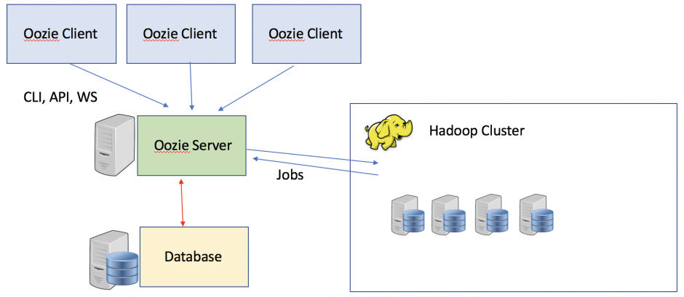
Oozie Architecture
Notes:
An Oozie Server is deployed as Java Web Application hosted in a Tomcat server, and all of the stageful information such as workflow definitions, jobs, etc, are stored in a database. This database can be either Apache Derby, HSQL, Oracle, MySQL, or PostgreSQL. There is an Oozie Client, which is the client that submits work, either via a CLI, and API, or a web service / REST.
● Oozie has client
– Launches jobs and talks to server
● Ozzie has server
– Controls jobs
– Launches jobs
● Pipelines
– Chained workflows
– Work flow output
– Is input to next

Slide 6
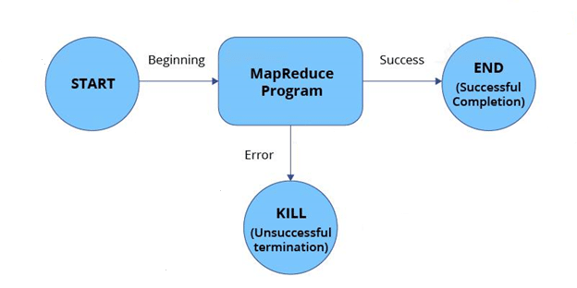
Working
Notes:
Basically, Oozie is a service that runs in the cluster. Workflow definitions are submitted by the clients for immediate processing. There are two nodes, namely, control-flow nodes and action nodes.
The action node is the one representing workflow tasks such as running a MapReduce task, importing data, running a Shell script, etc.
Next, the control-flow node is responsible for controlling the workflow execution in between actions. This is done by allowing constructs like conditional logic. The control-flow node includes a start node (used for starting a workflow job), an end node (designating the end of a job), and an error node (pointing to an error if any).
At the end of the workflow, HTTP callback is used by Oozie for updating the client with the workflow status.

Slide 7
Oozie Workflows
Workflow consists of workflow nodes, which can be of the following types:
Start Control Node
End Control Node
Kill Control Node
Decision Node
Fork Node
Join Node
Workflow Nodes
Notes:
An Oozie Workflow , as mentioned, is a workflow of tasks / actions that are to be carried out.
Each workflow consists of workflow nodes, which can be of the following types:
Start Control Node which is the starting point of the workflow. Every workflow must have one Start control node, and Oozie begins the execution of the workflow on that node
End Control Node what goes up must come down, and what starts must have at least one End Control Node. If a workflow makes it this far, it signifies that the workflow executed correctly without error. This generates the status of SUCCEEDED.
Kill Control Node is for the cases where we want to kill the execution of a workflow. This can happen on a branch following a decision, for example, where we want to stop execution in a KILLED state. There can be zero or multiple Kill Control nodes.
Decision Node corresponds to a switch statement or a case statement, and enables a list of predicates to be evaluated to determine flow direction, with a default case. A predicate is a JSP based language expression that returns True or False, so each predicate is evaluated in order and if True, that decision determines the flow direction. There can be zero or multiple Decision nodes.
Fork Node enables one path of execution to be split into multiple paths of execution There can be zero or multiple Fork Nodes.
Join Node is where the multiple fork node paths of execution rejoin. Workflow processing waits until the join is met by all the paths of a Fork. The Fork and Join nodes are pairs.
As well as workflow nodes, the Workflow consists of Action nodes, which are the jobs that need to be executed. When workflow execution arrives in an Action node, it executes the specified Action, and then waits until a callback from the executed process returns before continuing the workflow. Actions can be of the following types:
Hadoop fs
map reduce
ssh
pig
hive
sqoop
distcp
email
http
custom action

Slide 8
Features of Oozie
Oozie has client API and command line interface which can be used to launch, control and monitor job from Java application.
Using its Web Service APIs one can control jobs from anywhere.
Oozie has provision to execute jobs which are scheduled to run periodically.
Oozie has provision to send email notifications upon completion of jobs.

Slide 9
References
https://oozie.apache.org/
https://www.tutorialspoint.com/apache_oozie/
https://www.guru99.com/learn-oozie-in-5-minutes

Slide 10
Thank You

